Slide 1
Simulation of Elastic Fabric via Spring Network
By Lynn Serizawa

Slide 2
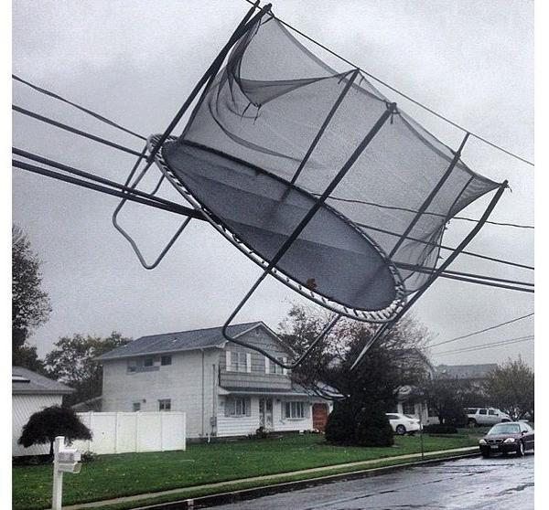
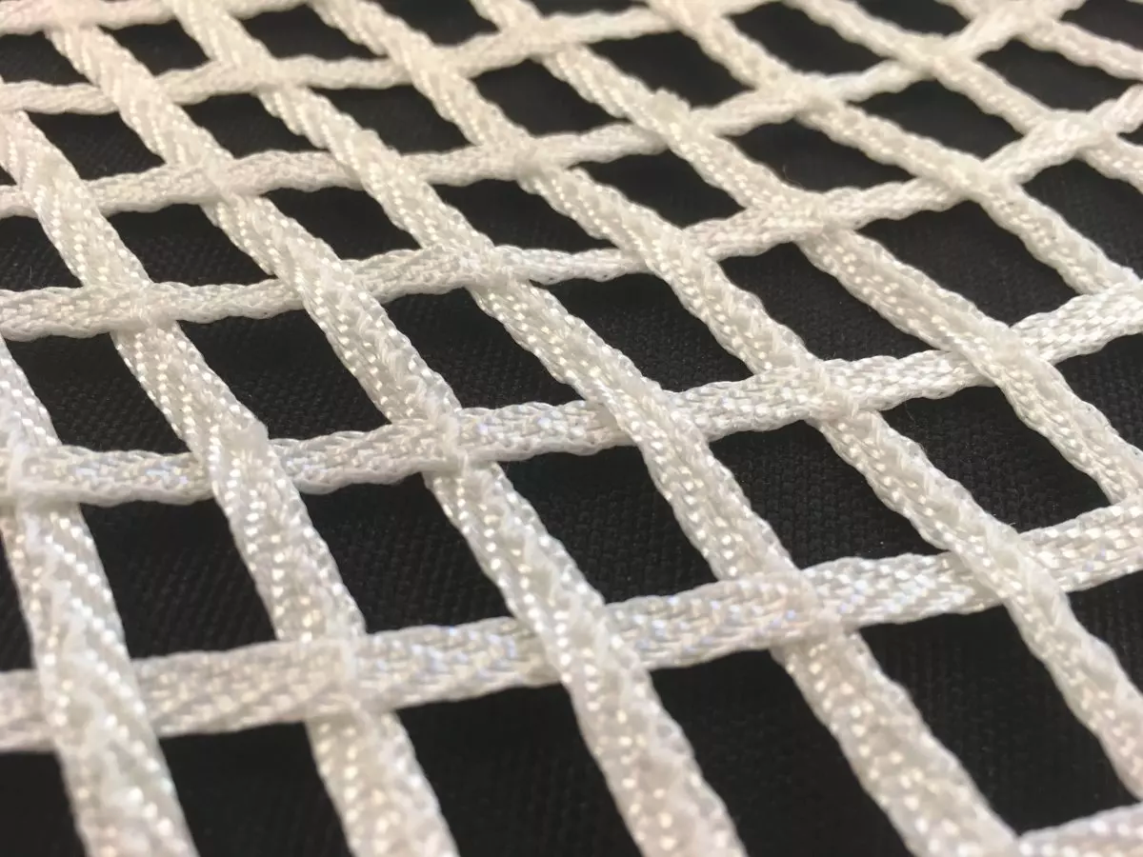
Introduction
Simulate net/trampoline
Network of springs

Slide 3
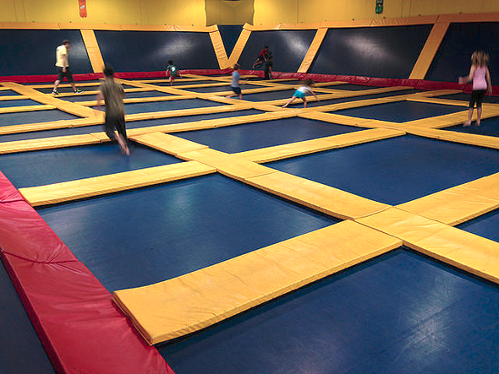

Slide 4
Applications

Slide 5
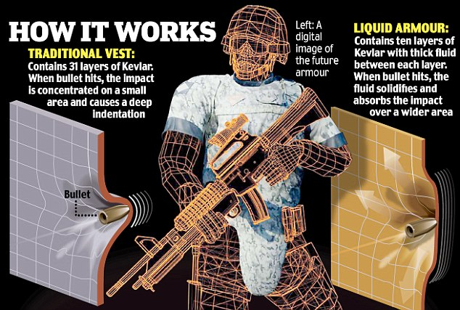
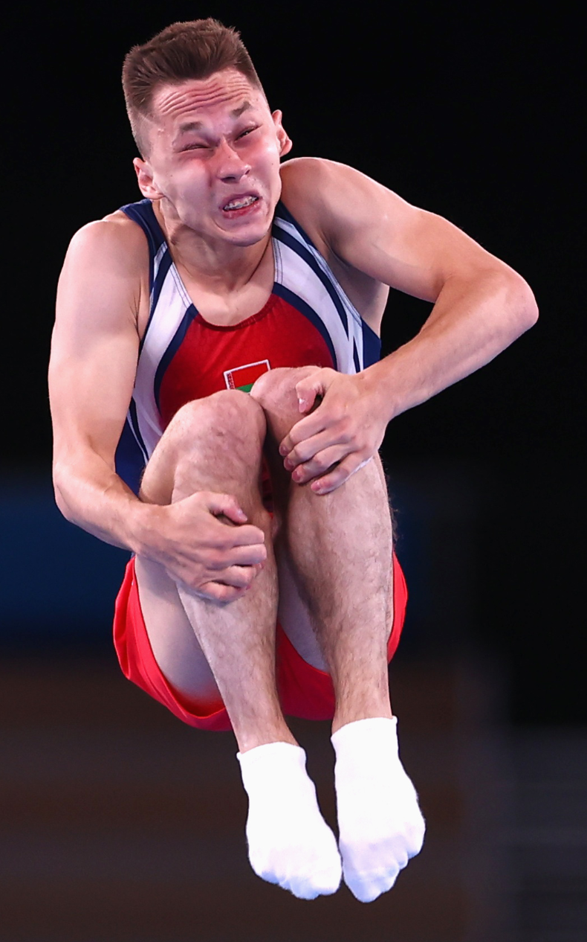
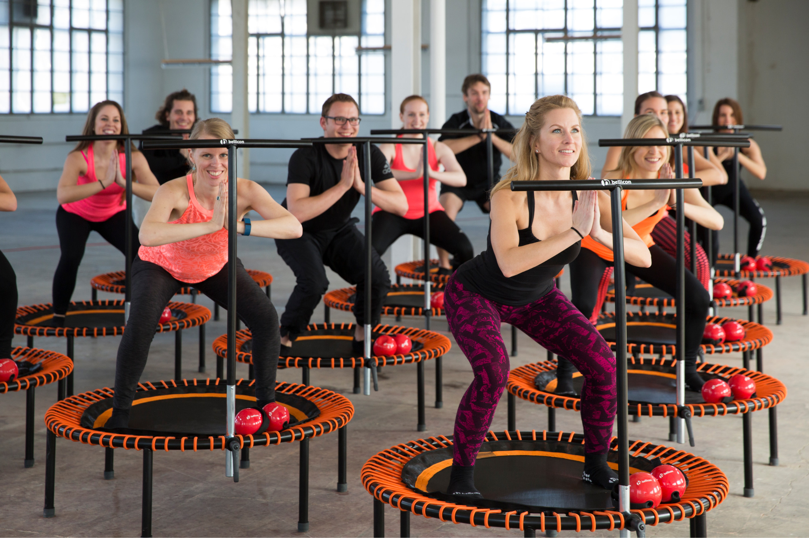
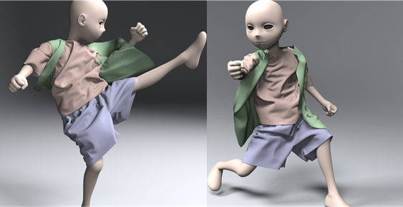
Applications
Cloth simulation
Material sciences
Material warping due to impact
Sports/Entertainment

Slide 6
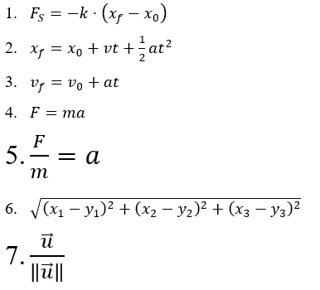
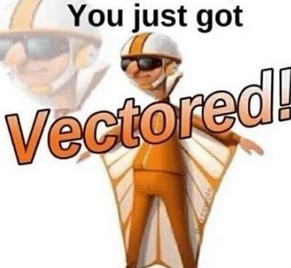
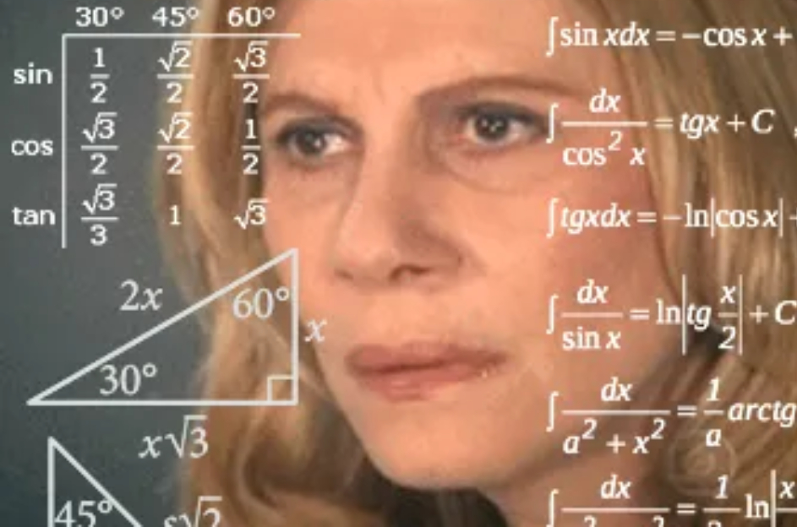
Equations/Theorems
Hooke’s Law (Spring) (1)
Motion Equations (2,3)
Newton’s Second Law (4,5)
Trigonometry/Vector Math (6,7,memes)

Slide 7
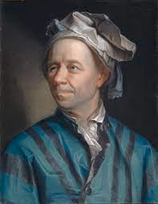
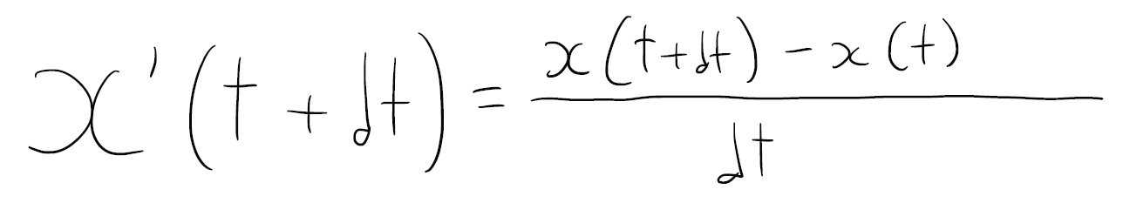
Numerical Method
Forward Euler’s Method
Iterate until we reach max t
Forward Euler
Backward Euler

Slide 8
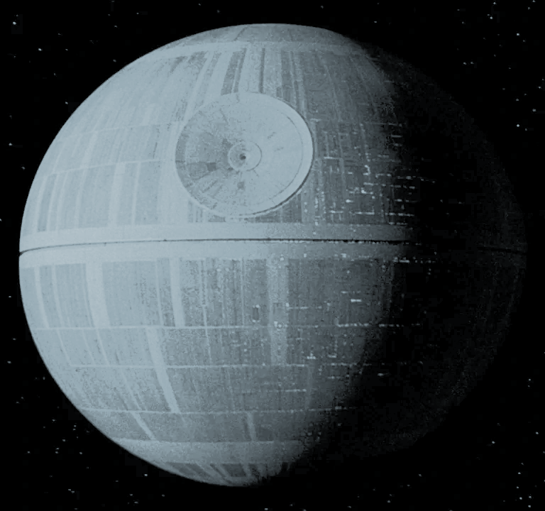
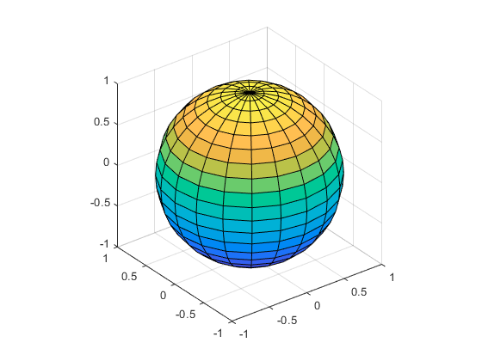
Workflow: Sphere
sphere(n)
Generates points
Kinematics equations
Add center point

Slide 9
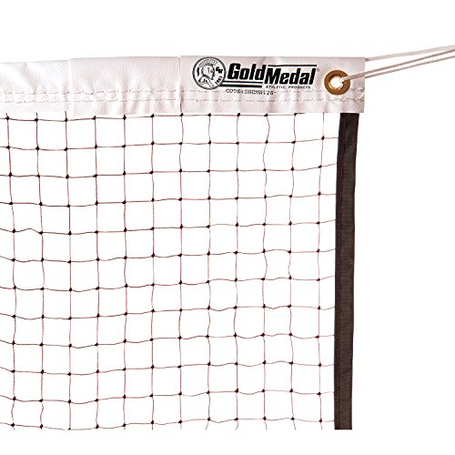
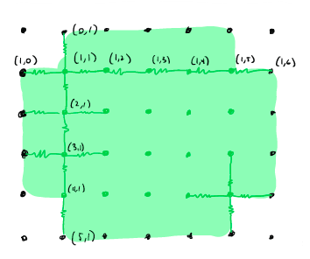
Workflow: Net
Build array for x, y, z components for position, velocity, acceleration of nodes
Kinematics, force on each node

Slide 10
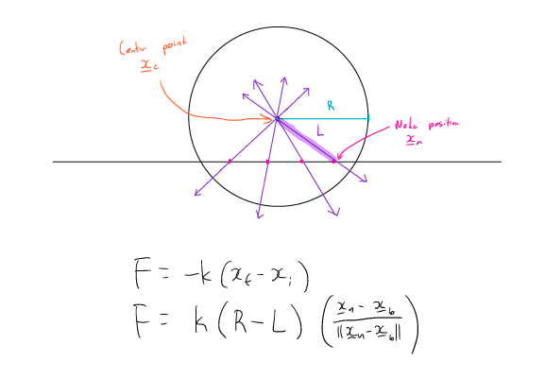
Workflow: Interaction Between Ball and Net
Thank you Professor Peskin for explaining this to me!

Slide 11
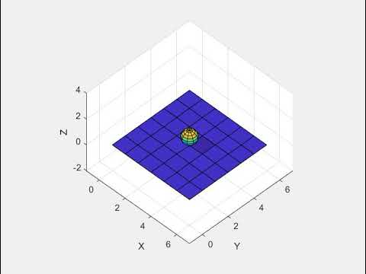
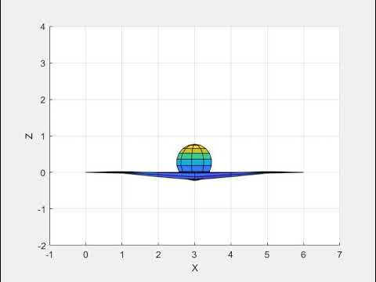
Results (Control)
Mass: 1kg | Radius: 0.5m | g=-9.8m/s² | Initial pos: (3,3,1.5) | Initial vel., acc.: 0
Net Dim: 7 x 7 | Spring Coeff: 999 | Step: 0.001 | Duration: 5 sec
NOTE: Simulations simulate 5 sec, but video slowed down to 10 sec.

Slide 12
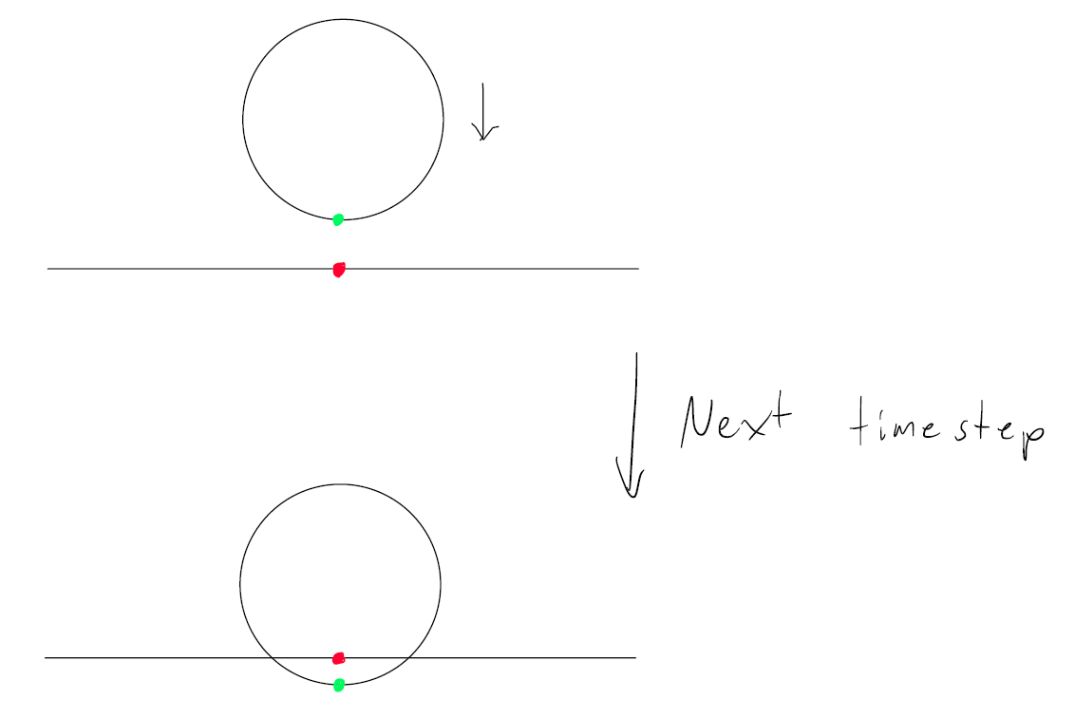
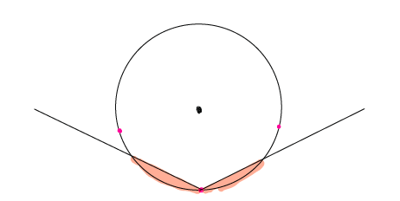
Leads to...

Slide 13
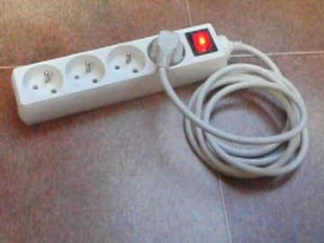
Energy Conservation Issues
Sphere “clips” through the springs
Energy graph (next slide)
Change in energy graph based on sphere faces and dimensions of trampoline
Start at height 4m, in center, mass 1kg
Other variables remain constant

Slide 14
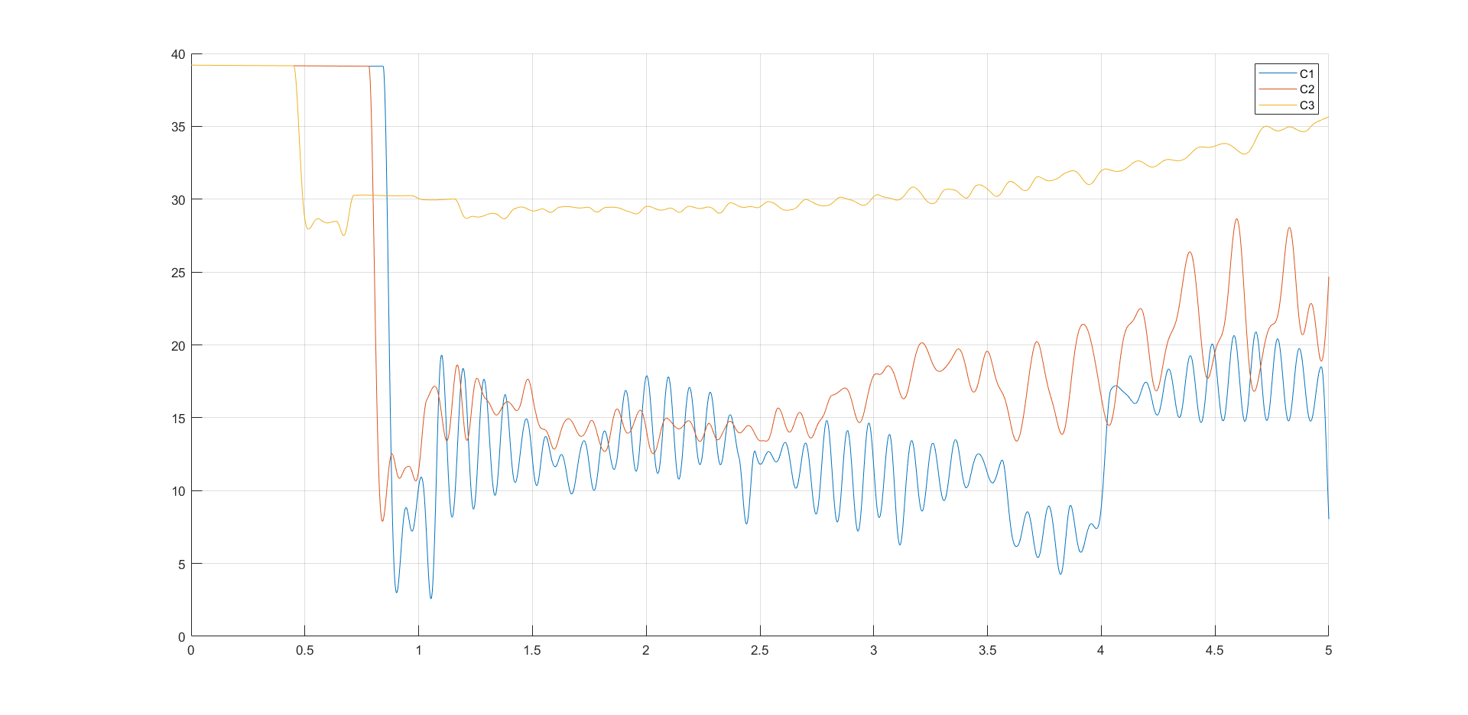
Total
Energy
(J)
Time (s)
Name | Net Dimension | Radius | Sphere faces | Std. Dev.
C1 | 7 x 7 | 0.5 m | 9 | 10.5419 J
C2 | 14 x 14 | 1 m | 18 | 8.7403 J
C3 | 42 x 42 | 3 m | 54 | 3.0018 J

Slide 15
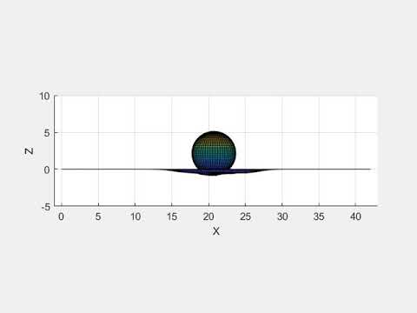
Mass: 5kg | Radius: 3m | g=-9.8m/s² | Initial pos: (21,21,4) | Initial vel., acc.: 0
Net Dim: 43 x 43 | Spring Coeff: 999 | Step: 0.001 | Duration: 5 sec

Slide 16
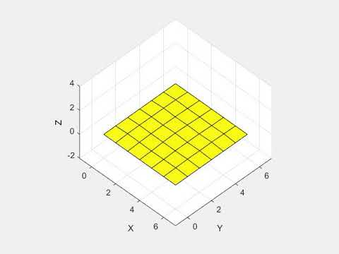
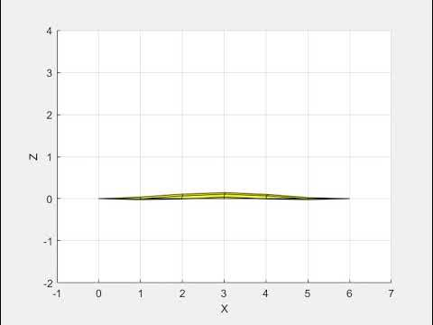
Results: Shape
Takes into account shape

Slide 17
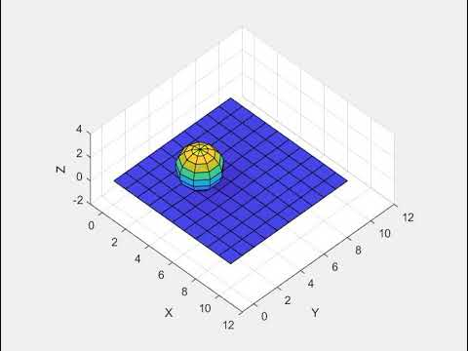
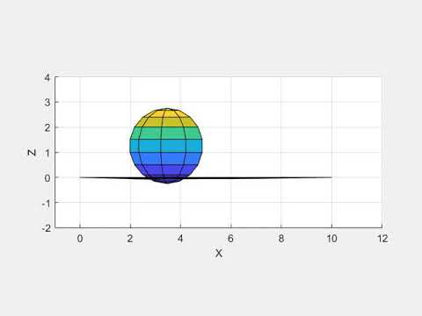
Results: Drop Away from Center
Initial position same, dimensions increased
Bounce

Slide 18
Summary
Network of springs to simulate a trampoline/net
Kinematics, spring force
Forward Euler’s method
Findings from modeling:
Model takes into account shape
Object bounces toward center
For most accuracy:
Timestep must be small
Increase n in sphere(n) if simulating net
Increase dimensions of trampoline

Slide 19
References
Euler method. Encyclopedia of Mathematics. URL: http://encyclopediaofmath.org/index.php?title=Euler_method&oldid=46859
Pelcovits, Robert A., and Joshua Farkas. Barron’s AP Physics C. 4th ed., Barron’s Educational Series, 2016.
Peskin, Charles. “Dynamics of Structures: Networks of Springs and Dashpots with Point Masses at the Nodes” New York University, MATH-UA 395, https://www.math.nyu.edu/~peskin/modsim_lecture_notes/structural_mechanics.pdf, accessed 5 Nov. 2021.
“Sphere.” MathWorks Help Center, MathWorks Inc., https://www.mathworks.com/help/matlab/ref/sphere.html.
Strang, Gilbert. Introduction to Linear Algebra. Cambridge Press, 2016.
“Trampoline.” Encyclopædia Britannica, Encyclopædia Britannica, Inc., https://www.britannica.com/sports/trampoline.

Slide 20
References
Media
YouTube Videos are from my YouTube channels
https://twitter.com/gma/status/262984825068191744
https://www.reuters.com/lifestyle/sports/gymnastics-belarusian-litvinovich-wins-mens-trampoline-gold-2021-07-31/
https://rsparks.fi/en/shop/rs-trampoline-web-bed-14x14/
https://www.510families.com/bay-area-trampoline-parks/
http://gamma.cs.unc.edu/CAMA/
https://www.dailymail.co.uk/sciencetech/article-1346877/Bullet-proof-custard-British-soldiers-wearing-revolutionary-new-liquid-body-armour-years.html
https://www.bellicon.com/gb_en/news/news-and-events/mini-trampoline-exercises
https://knowyourmeme.com/memes/you-just-got-vectored
https://knowyourmeme.com/memes/math-lady-confused-lady
https://en.wikipedia.org/wiki/File:Leonhard_Euler.jpg
https://starwars.fandom.com/wiki/Death_Star
https://indoorchamp.com/badminton-nets/
https://twitter.com/stopeatingbees/status/889863569252200449

